Slide 1
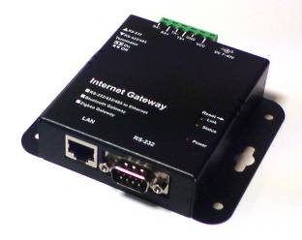
ZIGBEE Network Introduction
Integrated with Zigbee or Bluetooth products
Operation voltage : DC 7V ~ 40V.
RS232 Interface
Meets or Exceeds TIA/EIA-232-F and ITU Recommendation V.28
Interface : ±12V levels compatibility.
Data rate : 1200 bps up to 921600 bps
Characters : 5, 6, 7, 8
Parity : None, Even, Odd
Stop bits : 1, 1.5, 2
Control signals : TxD, RxD, GND
RS422/RS485 Interface
Meet the requirement of the EIA/TIA-485
4-wire signals : TX+,TX-,RX+,RX-,GND
Support terminal resistor for TX and RX.
Up to connect 256 devices on the bus.
Maximum bit rate up to 115K bps.
Bus protection:
±30KV, IEC 61000-4-2, Contact/Air Discharge.
±30KV, IEC 61000-4-4, EFT(5/50ns).
±30KV, IEC 61000-4-5, Surge(8/20us).

Slide 2
ZIGBEE Network Introduction
Integrated with Zigbee or Bluetooth products
Ethernet Interface
Built-in 1.5KV magnetic isolation.
Ethernet Interface : 10Base-T, 100Base-TX
Ethernet Speed/Duplex : Auto-negotiation 10/100Mbps, Full/Half duplex
Protocols Supported : ARP, IP, ICMP,UDP, TCP, DHCP, TFTP, HTTP.
Network Services : TCP Server, TCP Client, Web Control.
Auto-MDIX : Yes
Build-in web server setting page for parameter by user.
Support all operation system, don’t need any driver.
Cross domain parameter setting utility for windows XP/VISTA/windows 7.
Support V irtual Serial Port (VSP) utility for simulate RS232 COM port.

Slide 3
ZIGBEE Network Introduction
Default setting:
The module default IP address is 192.168.0.1, this module build-in a homepage for setting, so user can change internal parameter setting by browser.

Slide 4
Configure the Gateway
Quick start:
1. Connect RJ45 to Ethernet.
2. Select RS232 or RS422/RS485 mode.
3. Connect RS232 DB9 or RS422/RS485 4-wires bus.
4. Connect DC power input.
5. Check LED indicator.
User can use browser and entry the URL(http://192.168.0.1/setting.htm) for setting.

Slide 5
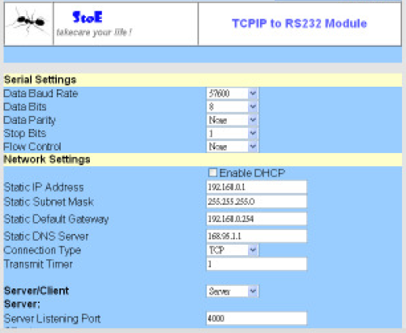
Set up the Serial port & Network port
Setup screen.

Slide 6
Network setting
Network setting:
DHCP : Enable DHCP function.
IP Address : Static IP address，use IPv4 define.
Subnet Mask : Mask address， ”255.255.255.0”
Gateway : Gateway address， ”xxx.xxx.xxx.254”。
DNS server : DNS address, Can point to any one DNS server, factory default value is 168.95.1.1

Slide 7
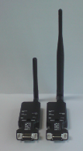
Power Adapter
Low Power : External 2dBi Dipole Antenna
2. High Power : External 5dBi Dipole Antenna

Slide 8
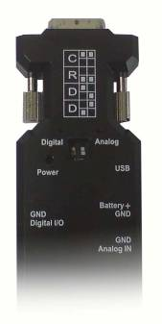
Configuration
  Adapter Profiles
Firmware Switching by DIP Switch
C: Coordinator
R: Router
D: Device
RS-232 DB9 Connector
Blue LED: Digital
Blue LED: Analog
DIP Switch for Firmware
Mini USB
Red LED: Power
External Battery Jack
Digital I/O Jack
Analog Input Jack

Slide 9
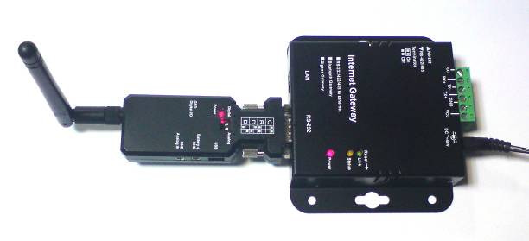
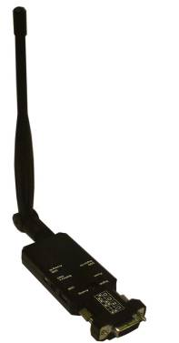
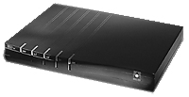
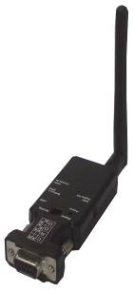
Configuration
IP
Network
ADSL/VDSL Modem
ZIGBEE Gateway

Slide 10
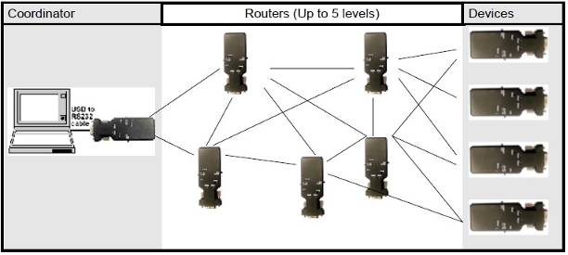
Configuration
Local Mesh Network

Slide 11
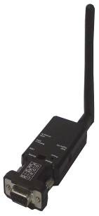

Link Distance
Low Power: 30~50 meters (Open Space)
High Power: 500~800 meters (Open Space)
Up to 5 levels or 20 nodes in one level
For example :
Router can be up to 5 level.
Coordinator
Device

Slide 12
Repeaters
Put a Repeater where you want to add.
Signal is declined very much.
A
C
B
Repeater

Slide 13
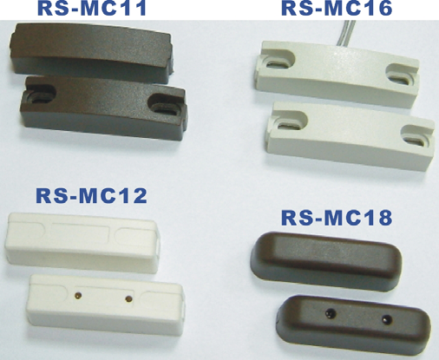
Application 1 for multiple buildings
Anti Thief stealing the Battery!! (at local area)
GSM Base station 1
GSM Base station 2
Battery Box with door sensor
Battery Box with door sensor

Slide 14
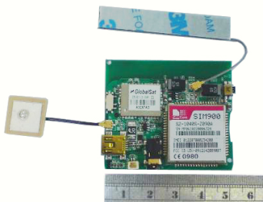
Application 2 for single building
GPS Tracker
Anti Thief stealing the Battery!! (at farend )
Tx/Rx
GSM Base station
DI/DO
Battery Box with door sensor

Slide 15
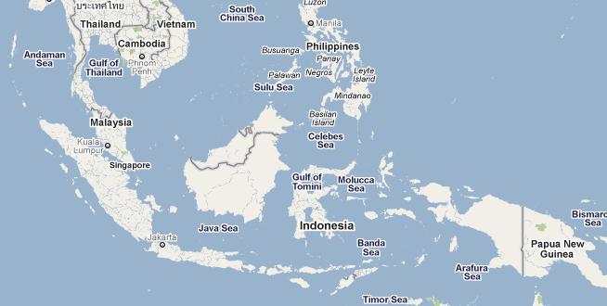

ZigBee with GPS Tracker
GPS Tracker
Tx/Rx
GSM Base station
DI/DO
The staffs will receive the MMS
message and GPS Google map.
Battery Box with door sensor

